Slide 1
StayMatch Application
Team 3
Project Manager- Prathima Seethalam
Team Members- Shubham Mishra, Rahul Mendes, Kritika Agarwal, Akshat Shanbhag, Ajay Peduri, Daulet Kapezov, Dhruv Chamaria

Slide 2
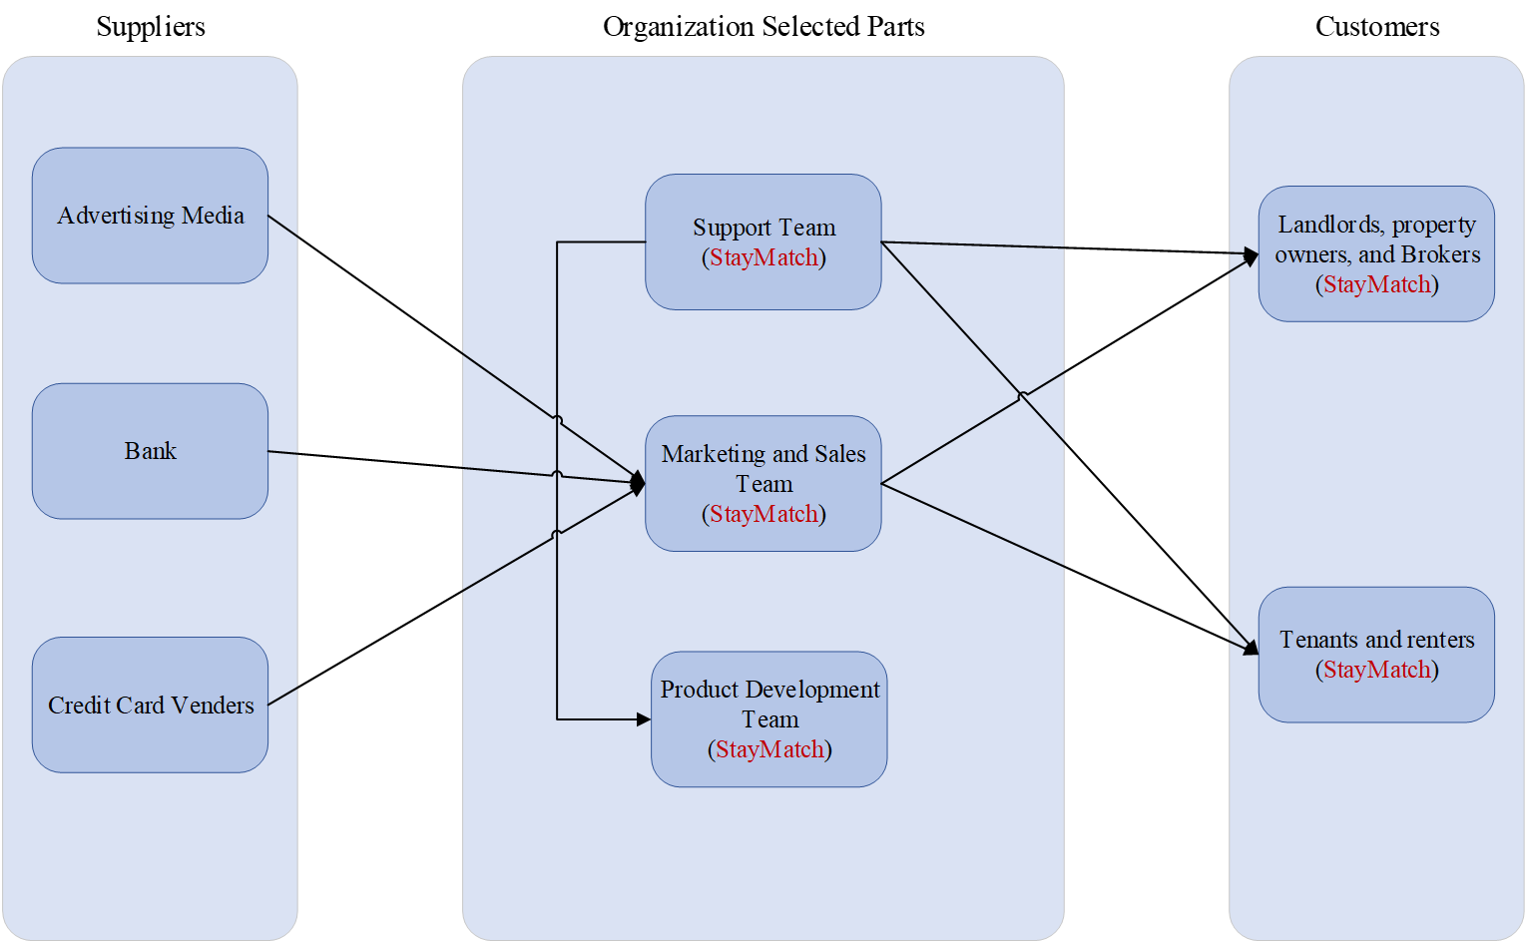
BRM diagram - Presented by Daulet Kapezov

Slide 3
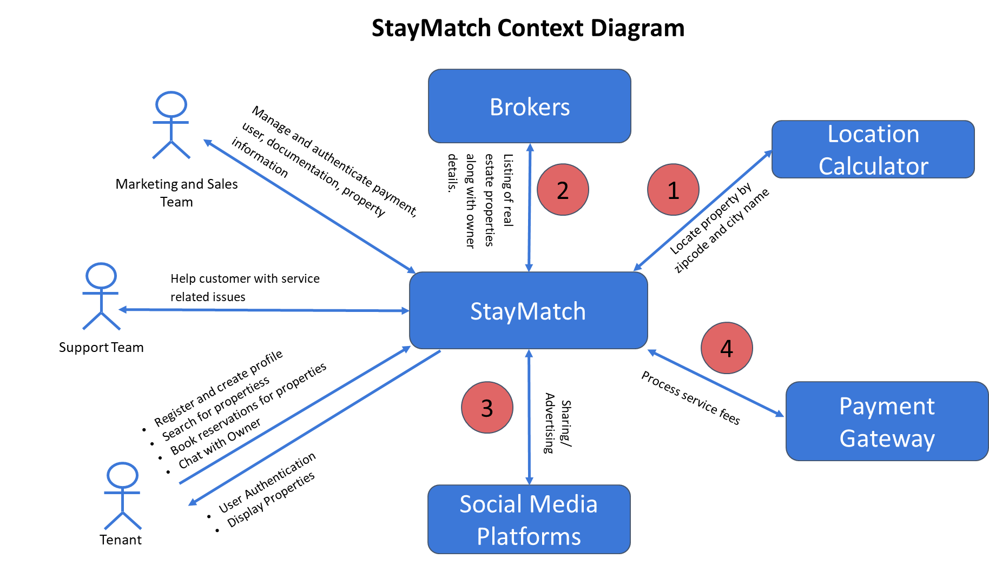
Context Diagram - Presented by Shubham Mishra

Slide 4
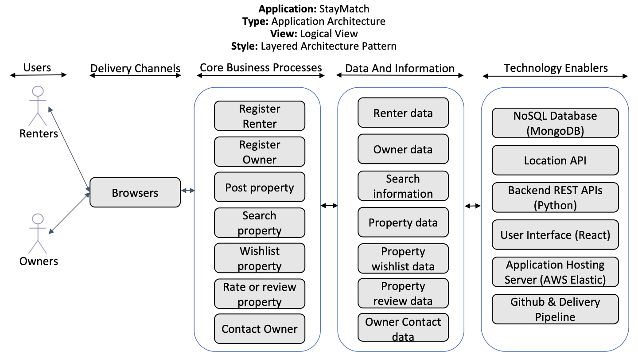
Presented by Kritika Agarwal

Slide 5
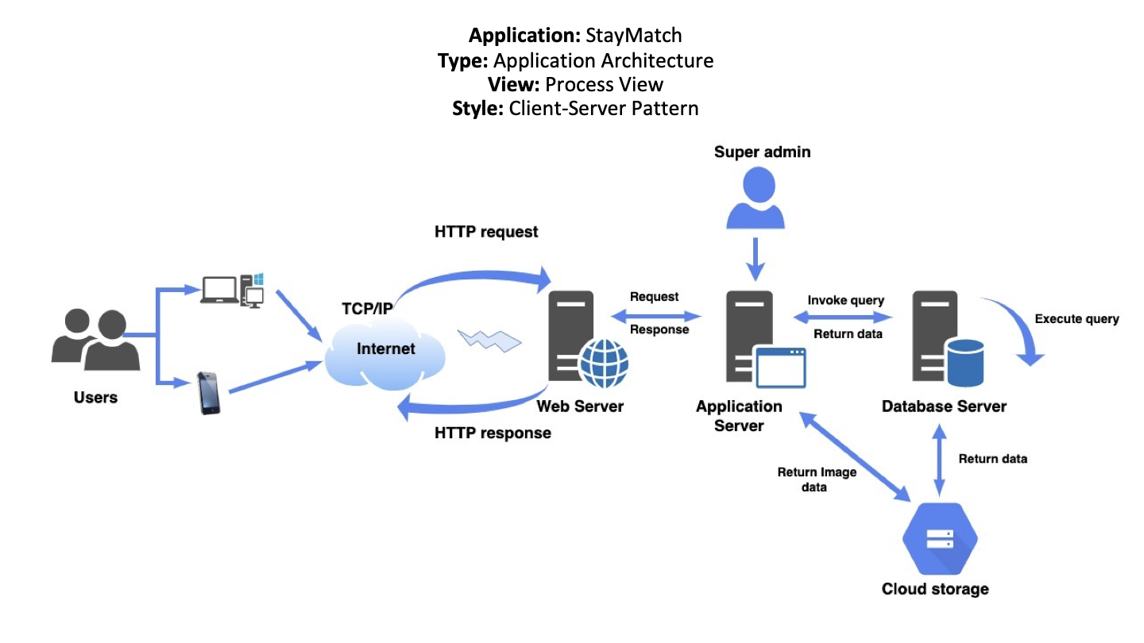
Presented by Kritika Agarwal

Slide 6
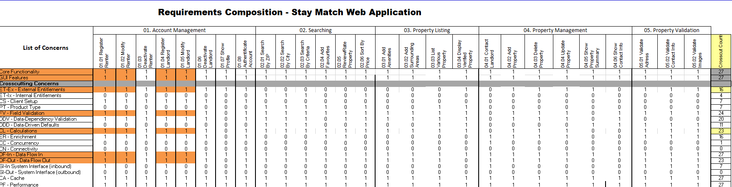
RCT - Presented by Prathima, Seethalam

Slide 7
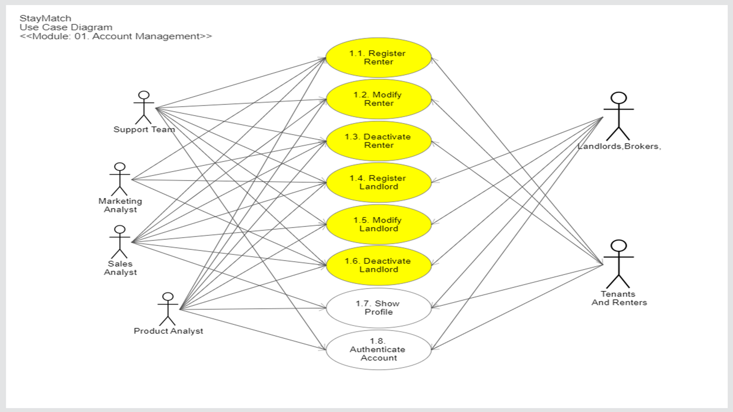
Use Case Diagram - Presented by Shubham Mishra

Slide 8
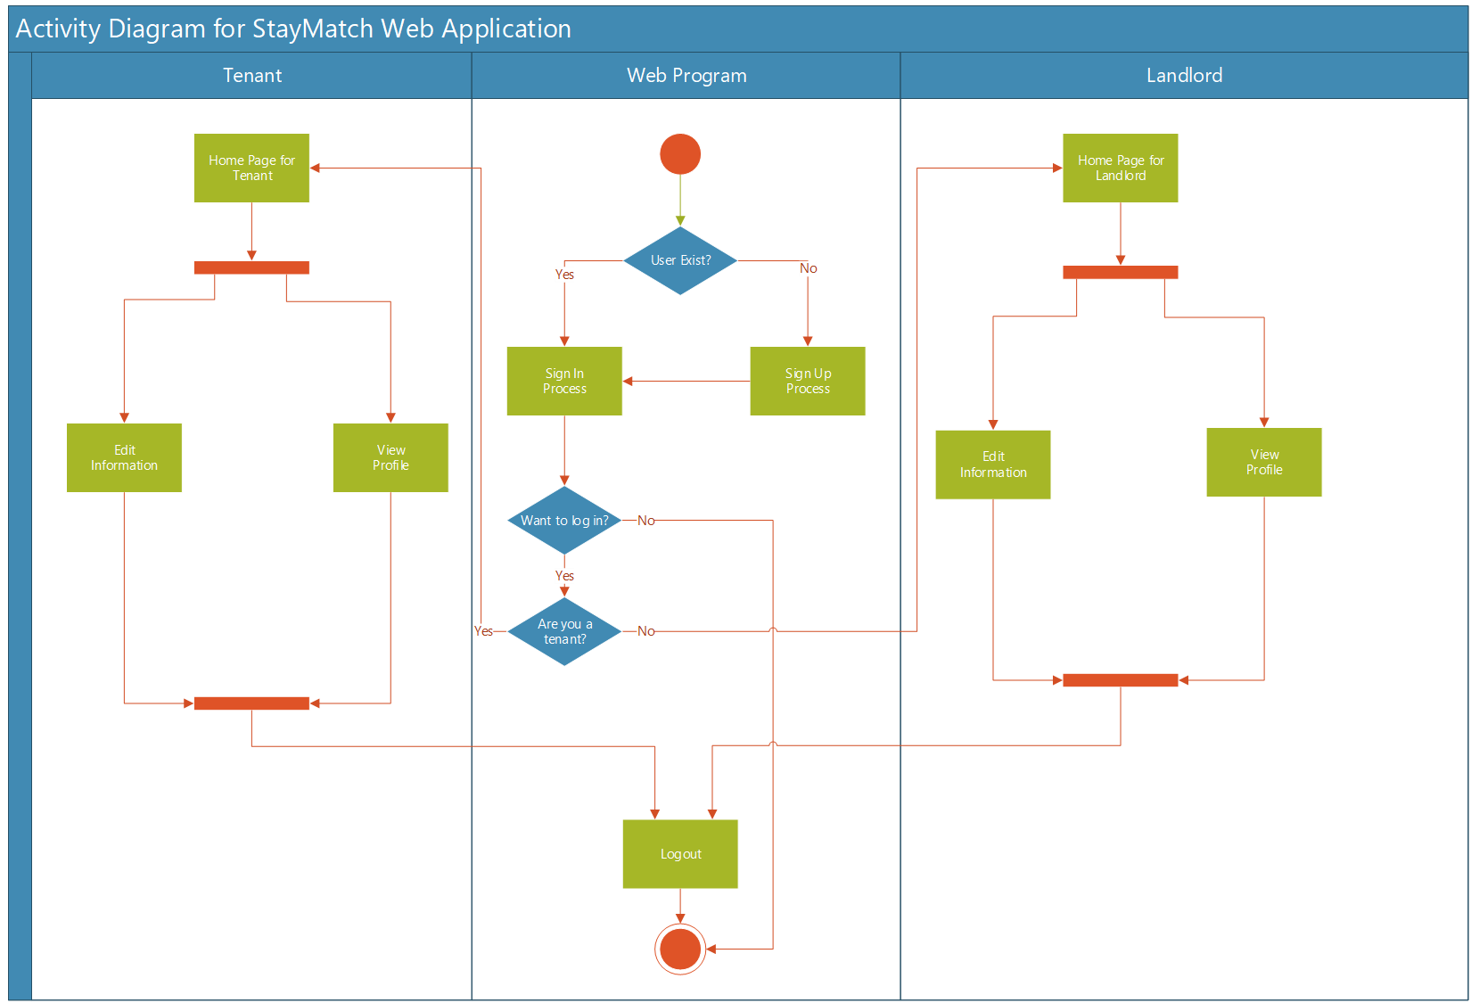
Activity Diagram - Presented by Daulet Kapezov

Slide 9
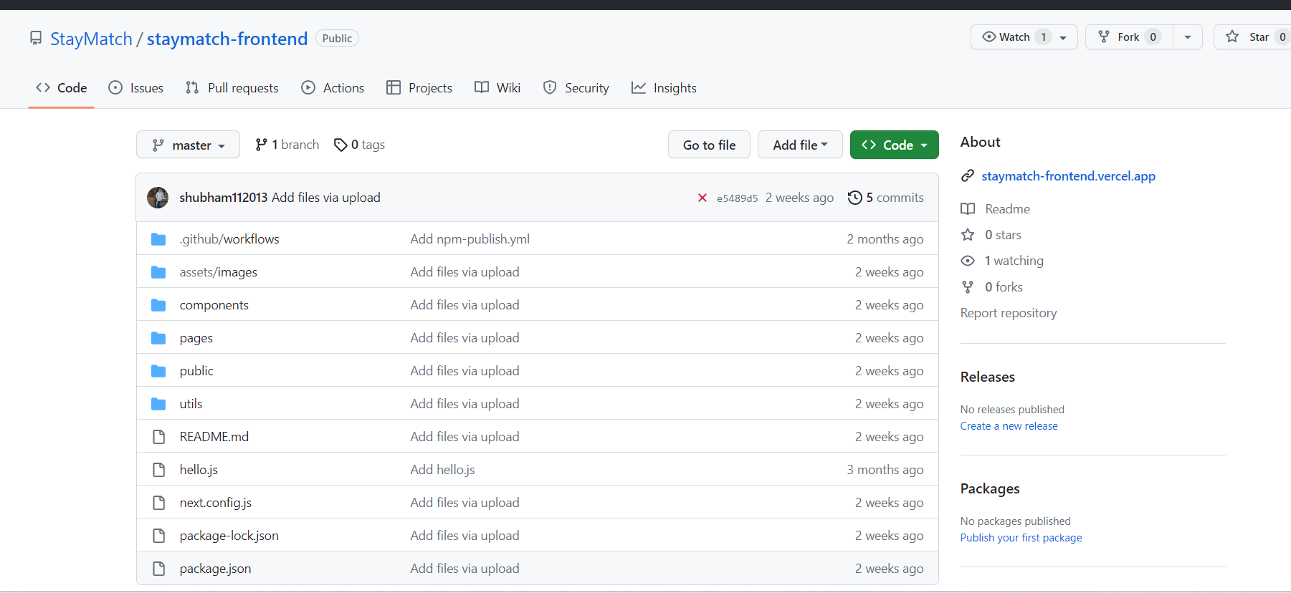
Github Frontend - Presented by Prathima, Seethalam

Slide 10
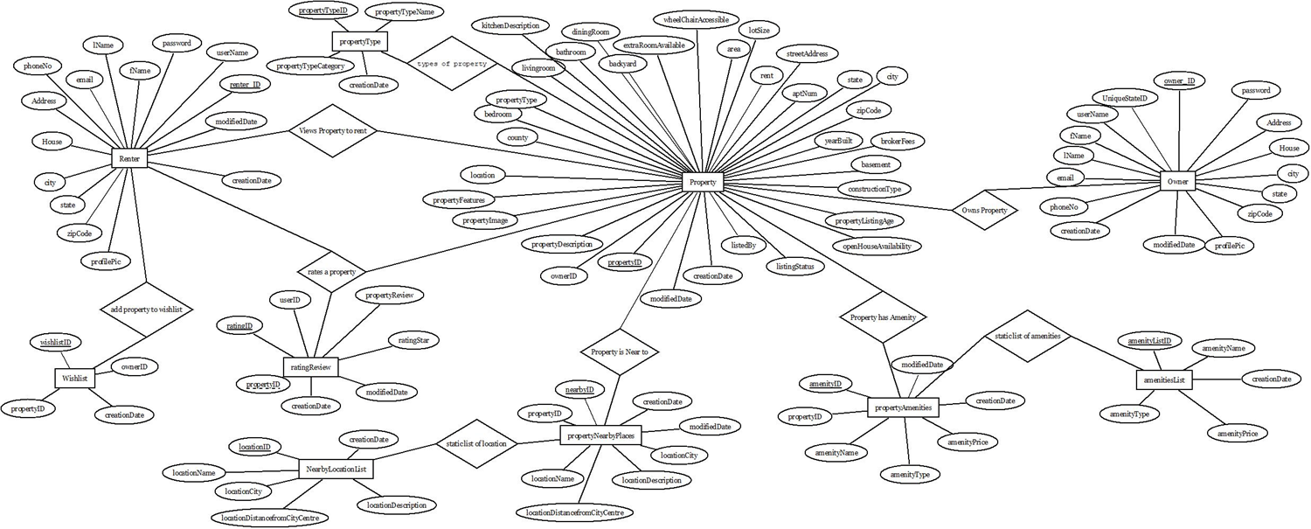
Conceptual ER Diagram - Presented by Rahul Mendes
StayMatch Web Application

Slide 11
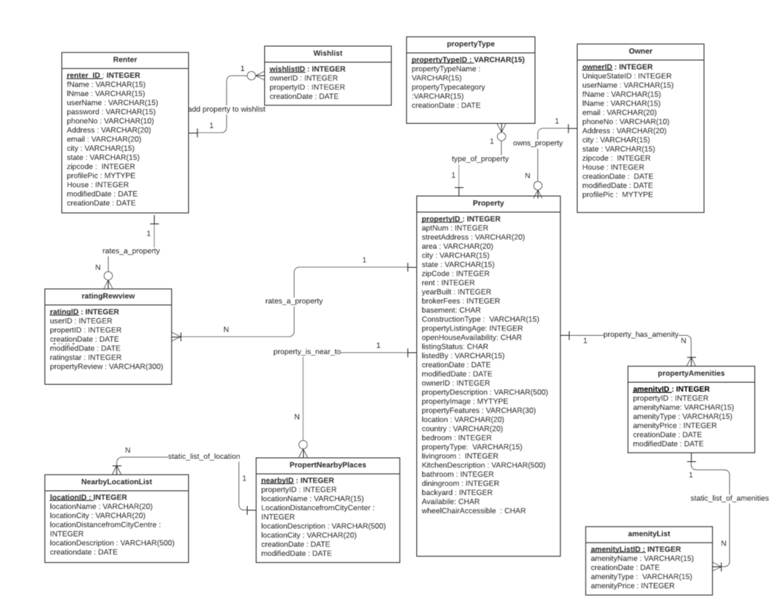
Logical ERD Diagram - Presented by Rahul Mendes
StayMatch Web Application

Slide 12
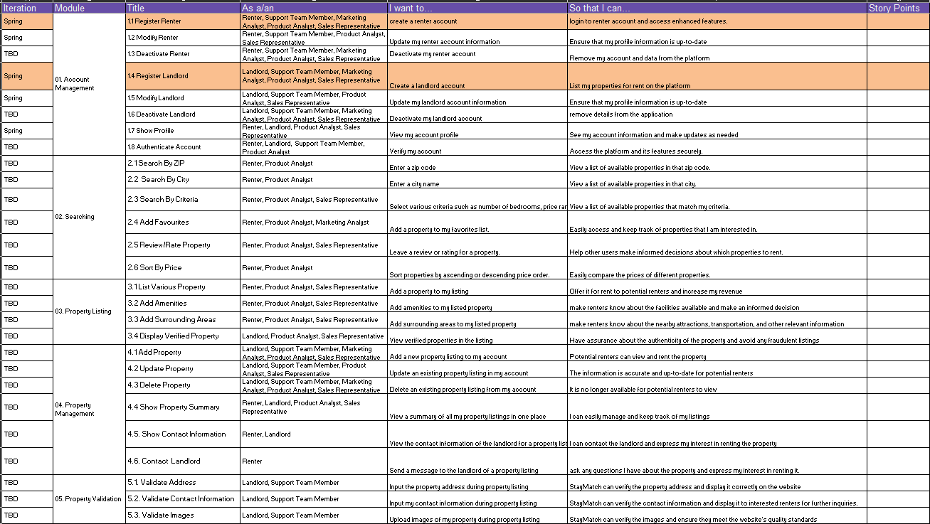
Functional Specifications User Stories - Presented by Dhruv Chamaria

Slide 13
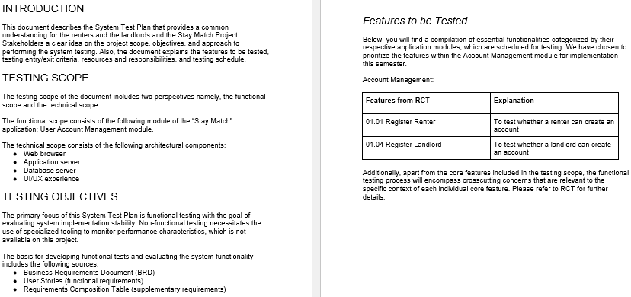
SYSTEM TEST PLAN - Presented By Akshat Shanbhag

Slide 14
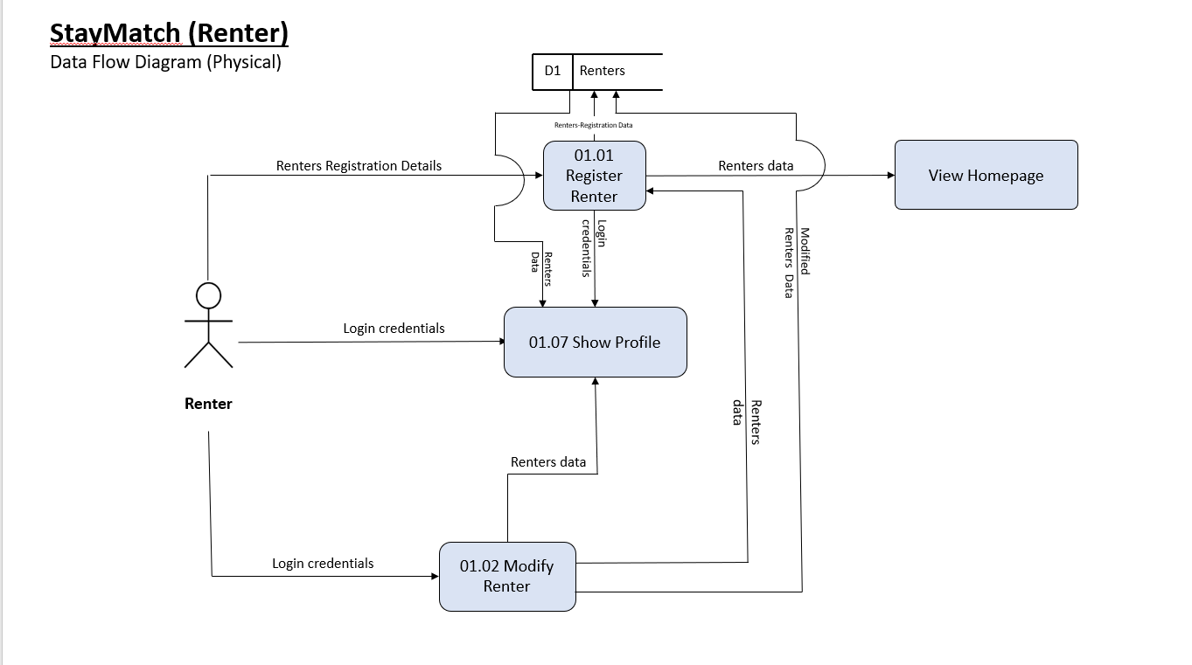
Presented by Ajay Kumar

Slide 15
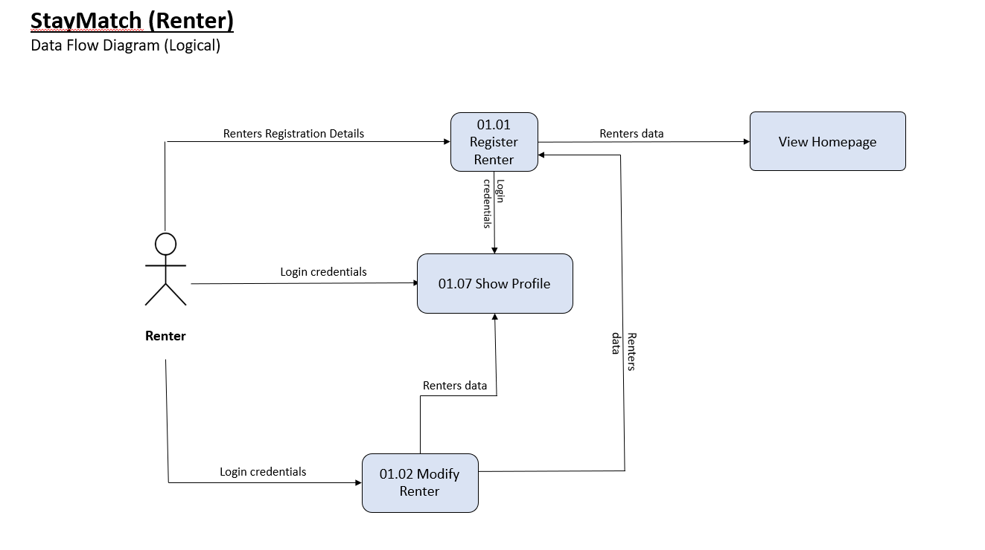
Presented by Ajay Kumar

Slide 16
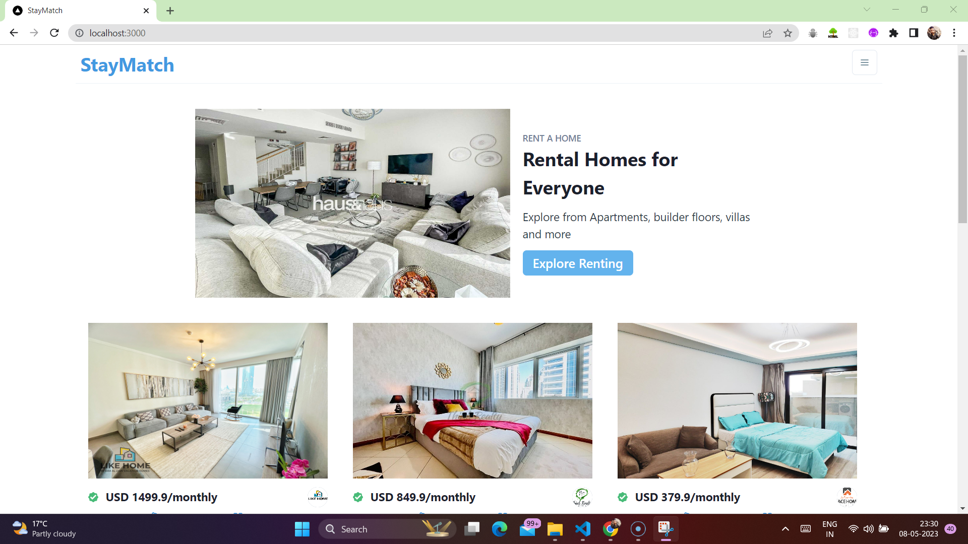
Application Demo – Presented by Prathima, Seethalam

